Slide 1
Presented by:
Amey Kumar 23070123019
Anushka Shinde 23070123025
Jiya Palod 23070123070
Waste Classification
Using Deep Learning & Transfer Learning
Introduction to Deep Learning — CA 4
MobileNetV2 · Transfer Learning · Binary Classification
TensorFlow
MobileNetV2
Kaggle Dataset
IDL Course Project | 2025

Slide 2
Problem Statement & Objectives
The Problem
Objectives
🗑 Improper waste sorting is a major environmental issue
01
Binary Classification
Classify images as Organic or Recyclable
♻ Manual classification is slow, inconsistent & expensive
02
Transfer Learning
Leverage MobileNetV2 pre-trained on ImageNet
📦 Recyclable materials end up in landfills due to human error
03
High Accuracy
Achieve strong test accuracy via fine-tuning
🏭 Smart waste systems need automated sorting capability
04
Generalization
Apply augmentation to reduce overfitting

Slide 3
Working Model Overview
End-to-end transfer learning pipeline
📷
⚙️
🧠
🔗
✅
Input Images
Data Augmentation
MobileNetV2 Backbone
Custom Head
Output Classes
160×160 px RGB
Flip · Zoom Rescale
ImageNet Weights
GAP → Dense → Dropout
Organic / Recyclable
DATASET
CLASSES
FRAMEWORK
TRAINING
Kaggle: Waste Classification
2 — Organic (O) & Recyclable (R)
TensorFlow / Keras
Fine-tuning last 20 layers

Slide 4
Model Architecture & Hyperparameters
Architecture Layers
Hyperparameters
MobileNetV2 Base
Input Size
160 × 160 × 3
Pre-trained backbone, last 20 layers trainable
Batch Size
64
GlobalAveragePooling2D
Reduces spatial dimensions to 1280-d vector
Optimizer
Adam (lr = 0.0001)
Dense (128 units, ReLU activation)
Learns task-specific feature combinations
Loss
Categorical Crossentropy
Dropout (0.4)
Epochs
10 (EarlyStopping, patience=3)
Regularization — prevents overfitting
Dense (2, Softmax)
Frozen Layers
All but last 20 of MobileNetV2
Output layer — class probabilities
Augmentation
Horizontal flip, zoom ±10%

Slide 5
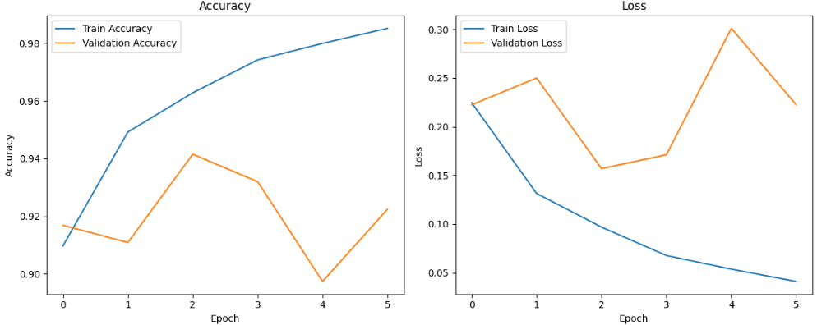
Training Results
Slide 1 of 2
~94%
~90%
~0.18
6 epoch
Train Accuracy
Val Accuracy
Final Val Loss
Early Stopping
Key Observations
✔ Model converged rapidly within ~6 epochs
✔ EarlyStopping prevented overfitting by restoring best weights
✔ Small learning rate (1e-4) ensured stable fine-tuning
✔ Data augmentation improved generalization on test set
✔ Train/Val accuracy gap < 3% — low overfitting
6

Slide 6
Evaluation & Sample Predictions
Slide 2 of 2
Per-Class Performance
Sample Predictions
Class
Precision
Recall
F1-Score
Support
🥦 Organic
🍌 Organic
Pulses
Carrots
Organic (O)
0.97
0.92
0.95
1401
✅ Correct
✅ Correct
Recyclable (R)
0.91
0.97
0.94
1112
Weighted Avg
0.94
0.94
0.95
2513
🥤 Recyclable
📦 Organic
Confusion Matrix (Estimated)
Plastic toy
Peels
✅ Correct
✅ Correct
Pred: Organic
Pred: Recyclable
Act: Organic
1289
112
🥬 Organic
🛍 Recyclable
Act: Recyclable
35
1077
Carrots
Straws
✅ Correct
✅ Correct

Slide 7
Observations & Future Improvements
📊 Observations
🚀 Future Improvements
High Accuracy
Multi-class Classification
Model achieved ~90% val accuracy using transfer learning with minimal training data.
Expand beyond 2 classes — plastic, glass, metal, e-waste — for real-world utility.
Fast Convergence
Larger Dataset
EarlyStopping triggered around epoch 4–5, showing efficient feature reuse from ImageNet.
Include more diverse waste images across geographies & lighting conditions.
Minimal Overfitting
Model Compression
Dropout + augmentation kept train-val gap under 3%, indicating good generalization.
Deploy MobileNetV2 on edge devices (Raspberry Pi, mobile) for physical waste bins.
Binary Simplicity
Real-time Detection
2-class problem well-suited for MobileNetV2; more complex waste streams may need richer data.
Integrate with a camera feed + YOLO-style detection for conveyor-belt sorting.

Slide 8
THANK YOU!
Pred: Recyclable
Act: Recyclable

